Slide 1
K-Nearest Neighbors Classification

Slide 2
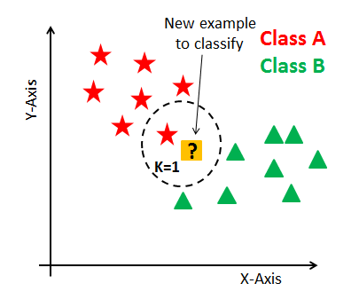
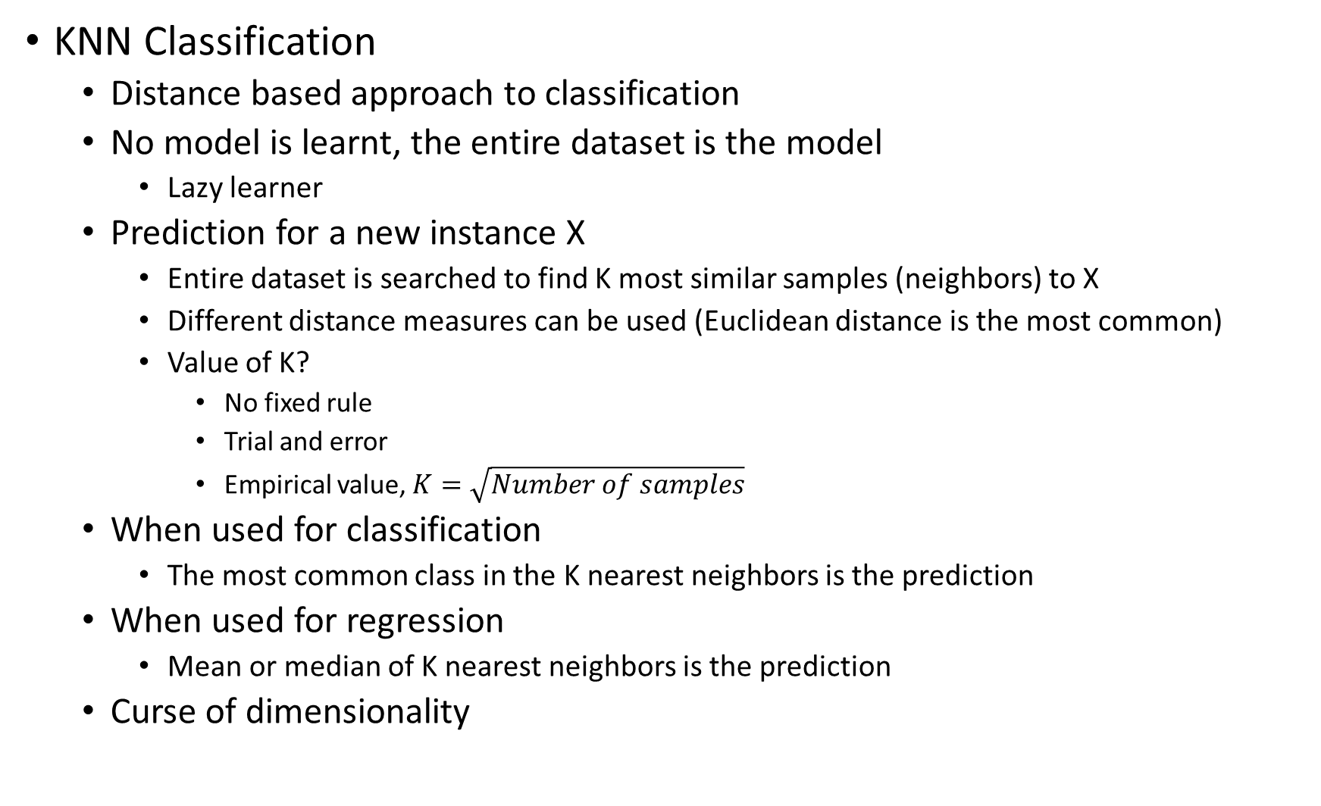
KNN Classification
Distance based approach to classification
No model is learnt, the entire dataset is the model
Lazy learner
Prediction for a new instance X
Entire dataset is searched to find K most similar samples (neighbors) to X
Different distance measures can be used (Euclidean distance is the most common)
Value of K?
No fixed rule
Trial and error
Empirical value, $K=\sqrt{Number of samples}$
When used for classification
The most common class in the K nearest neighbors is the prediction
When used for regression
Mean or median of K nearest neighbors is the prediction
Curse of dimensionality

